Slide 1
K-Nearest Neighbours
Y.LAKSHMI PRASAD
08978784848

Slide 2
Memory vs Learning
Memory is the process of recording, storing and retrieving information. In Memory, we keep the data and always go back to it whenever it is necessary.
Learning is the process or behavior of acquiring knowledge. It is the ability to implement the information and make use of it in practical circumstances.

Slide 3
KNN – Different names
K-Nearest Neighbors
Memory-Based Reasoning
Example-Based Reasoning
Instance-Based Learning
Case-Based Reasoning
Lazy Learning

Slide 4
Introduction to KNN
KNN is non-parametric, it means that it does not make any assumptions on the underlying data distribution.
In other words, the model structure is determined from the data.
KNN probably should be one of the first choices for a classification study when there is little or no prior knowledge about the distribution data.

Slide 5
Introduction to KNN
KNN is a simple yet powerful classification algorithm.
KNN is also known as a lazy algorithm since does not use the training data points to do any generalization.
Lack of generalization means that KNN keeps all the training data. To be more exact, all (or most) the training data is needed during the testing phase.

Slide 6
Introduction to KNN
KNN does not try to learn a function from the training data, so it is called Nonparametric model, It memorise the pattern from the dataset.
KNN requires no training for making predictions, which is typically one of the most difficult parts of a machine learning algorithm.

Slide 7
Nearest Neighbor Classifiers
Basic idea:
If it walks like a duck, quacks like a duck, then it’s probably a duck.
Compute Distance
Test Record
Training Records
Choose k of the “nearest” records

Slide 8
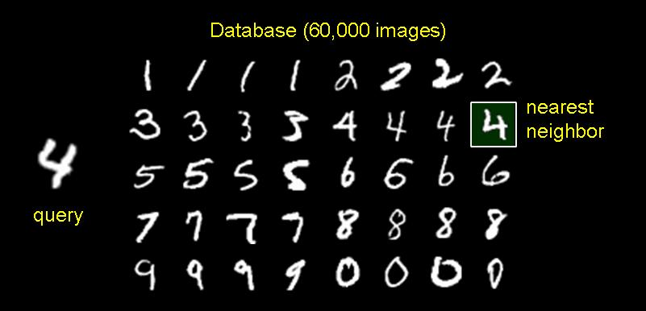
1-Nearest Neighbor Classifier
Training Examples (Instances)
Some for each CLASS
Test Examples
(What class to assign this?)

Slide 9
KNN's Idea
The intuition behind the KNN algorithm is one of the simplest of all the supervised machine learning algorithms.
1. It simply calculates the distance of a new data point to all other training data points. The distance can be of any type e.g., Euclidean or Manhattan etc.
2. It then selects the K-nearest data points, where K can be any integer.
3. Finally it assigns the data point to the class to which the majority of the K data points belong.
4. This algorithm segregates unlabeled data points into well-defined groups.

Slide 10
KNN's Idea
KNN Algorithm is based on feature similarity, How closely out-of-sample features resemble our training set determines how we classify a given data point.

Slide 11
KNN for Classification and Regression
KNN can be used for classification — the output is a class membership. An object is classified by a majority vote of its neighbours, with the object being assigned to the class most common among its k nearest neighbours.
KNN can also be used for regression — output is the value for the object. This value is the average (or median) of the values of its k nearest neighbours.

Slide 12
K - Nearest Neighbors
For a given instance ‘T’, get the top “K” dataset instances that are “nearest” to ‘T’.
Inspect the category of these “K” instances, choose the category “C” that represent the most instances.
Conclude that ‘T’ belongs to category “C”.

Slide 13
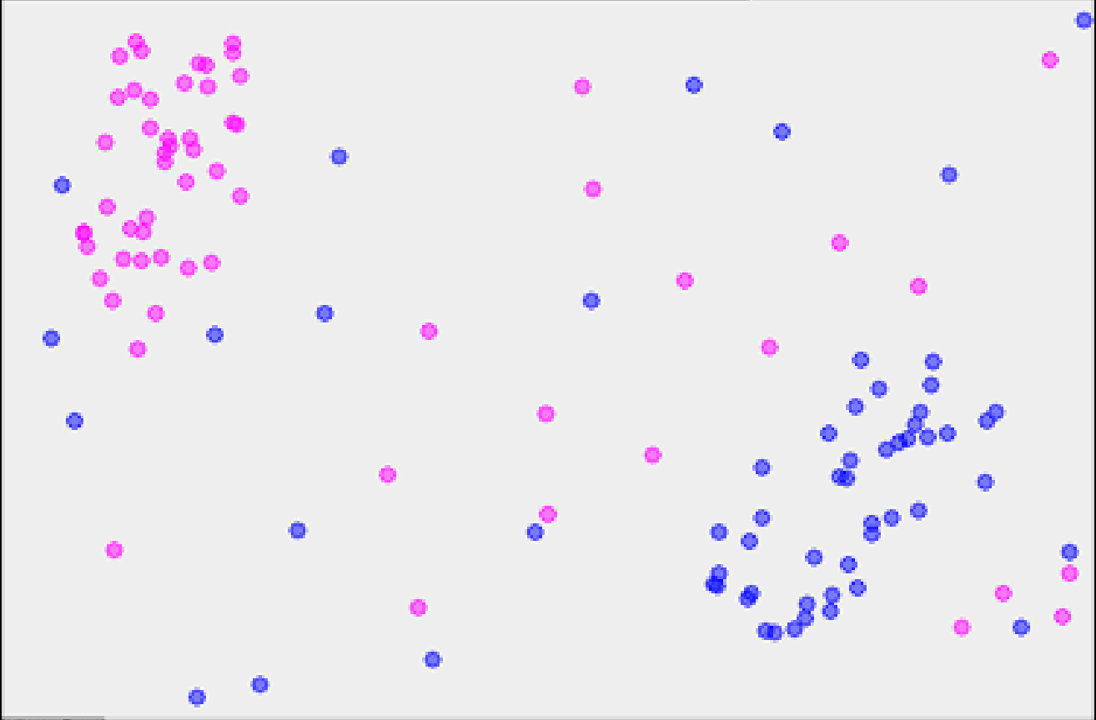
1-Nearest Neighbor
x

Slide 14
2-Nearest Neighbor
?

Slide 15
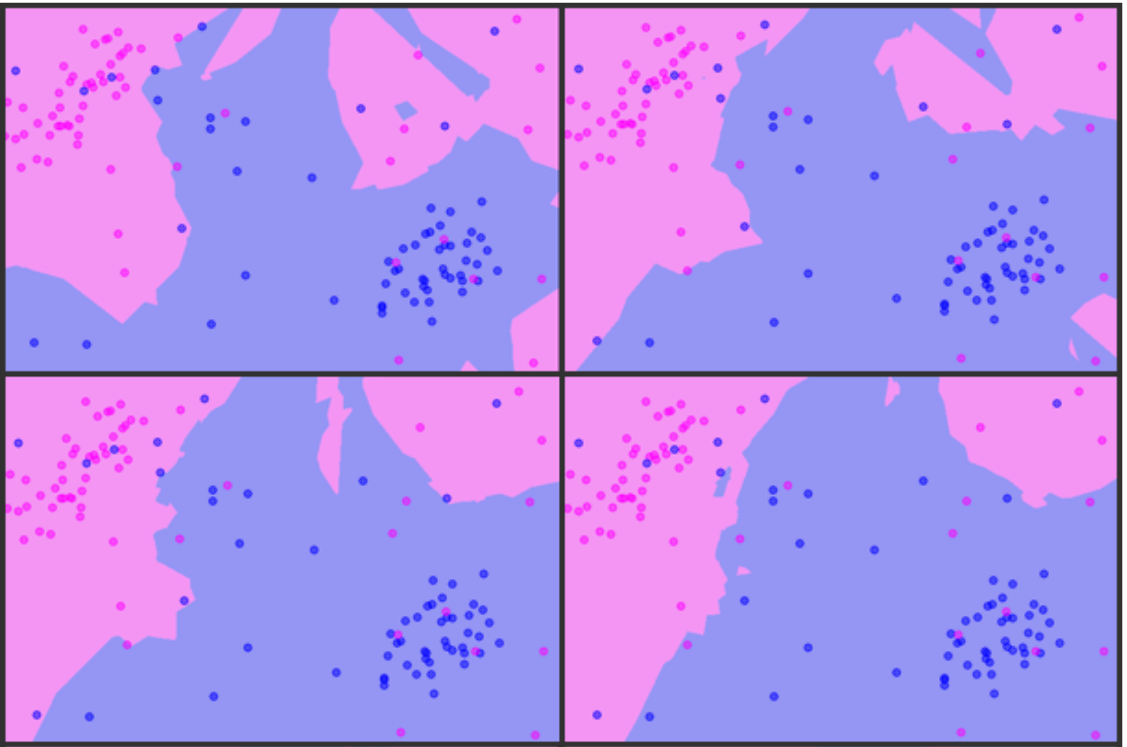
K = 3, 5, 7, 9

Slide 16
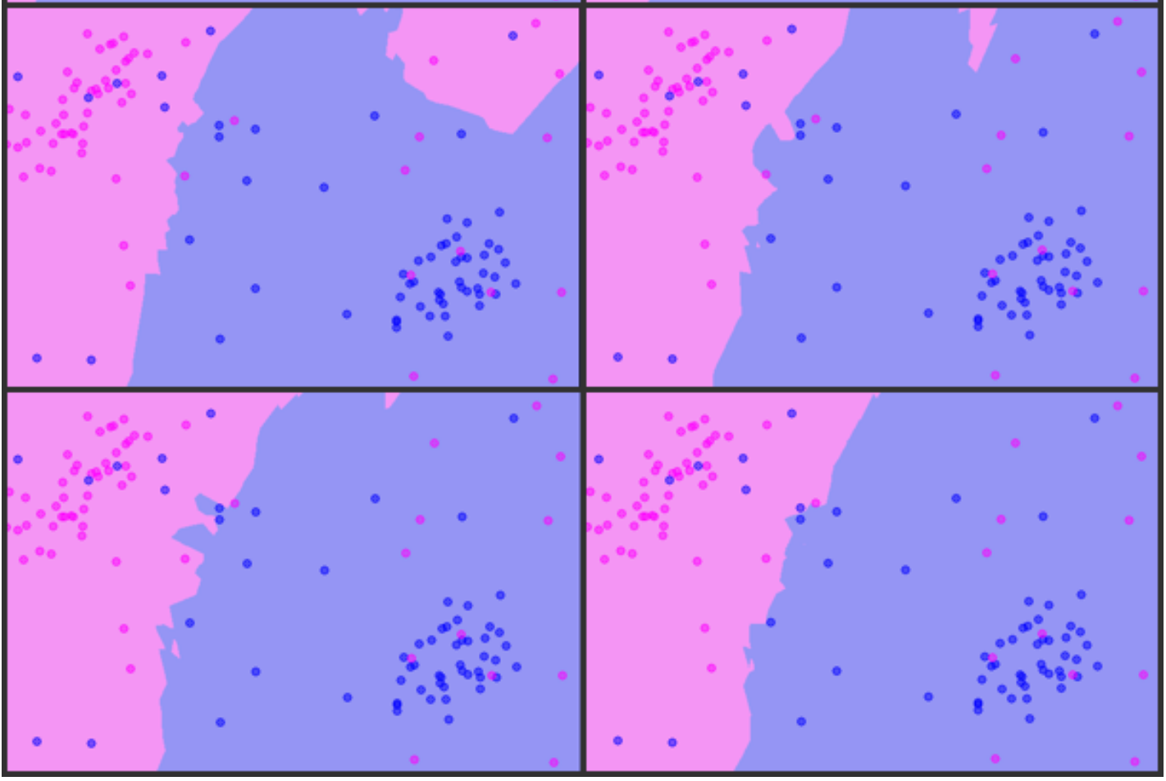
K = 11,13,15,17

Slide 17
Choosing The K
Choosing the number of nearest neighbors i.e. determining the value of ‘K’ plays a significant role in determining the efficacy of the model.
A large K- value has benefits which include reducing the variance due to the noisy data, the side effect being developing a bias due to which the learner tends to ignore the smaller patterns which may have useful insights.

Slide 18
Understanding K
Which of the following will be true about k in k-NN in terms of Bias?
A) When you increase the k the bias will be increases
B) When you decrease the k the bias will be increases
C) Can’t say
D) None of these

Slide 19
Feedback
Answer A: large K means simple model, simple model always consider as high bias

Slide 20
Noise in Data
When you find noise in data which of the following option would you consider in k-NN?
A) I will increase the value of k B) I will decrease the value of k C) Noise can not be dependent on value of k D) None of these

Slide 21
Feedback
Answer A: To be more sure of which classifications you make, you can try increasing the value of K.

Slide 22
Model complexity
K is hyper-parameter and we need to choose it that gives best performance.
If K is small, model is complex model can lead to overfit. It means that model memorizes the train sets and cannot predict test set with good accuracy.
If K is big, model that is less complex model can lead to under-fit.

Slide 23
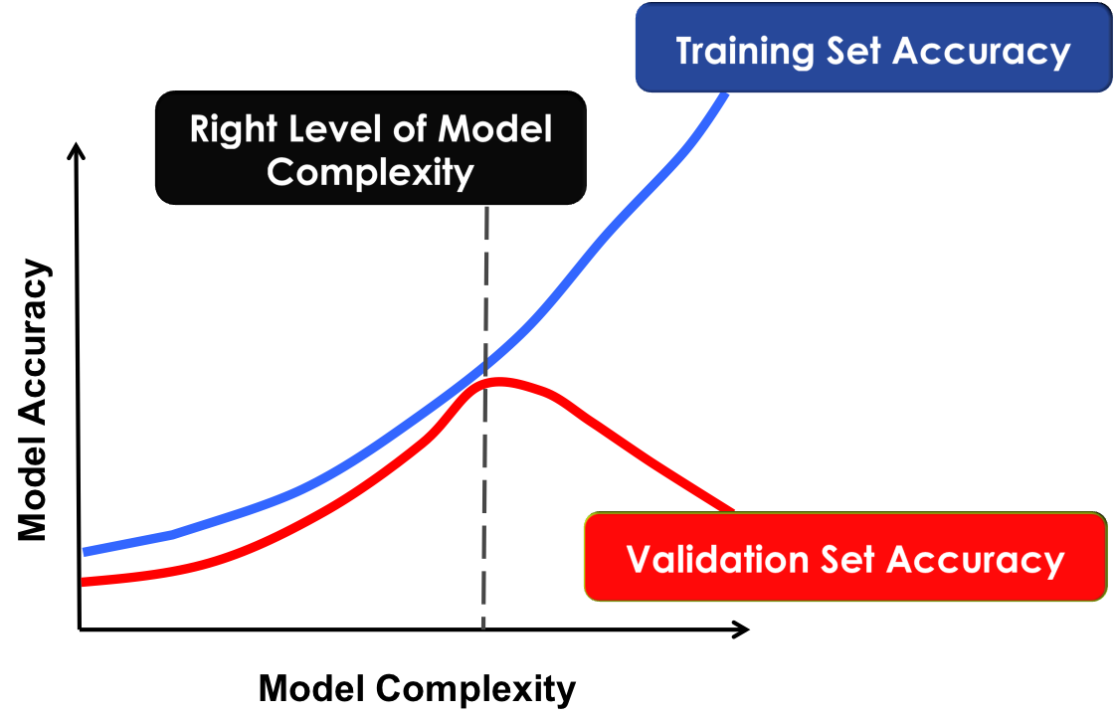
Controlling Complexity in KNN

Slide 24
K - Nearest Neighbors
Requires three things
1. The set of stored records
2. Distance Metric to compute distance between records
3. The value of ‘K’, the number of nearest neighbors to retrieve

Slide 25
K - Nearest Neighbors
To classify an unknown record:
1. Compute distance to other training records
2. Identify k nearest neighbors
3. Use class labels of nearest neighbors to determine the class label of unknown record (e.g., by taking majority vote)

Slide 26
Which distance Metric to use?
When you have Numeric variables we use Euclidean distance, When you have Categorical variables we use Hamming distance.

Slide 27
Nearest Neighbor Classification
Compute distance between two points:
Euclidean distance
Determine the class from nearest neighbor list
Take the majority vote of class labels among the k-nearest neighbors
Weigh the vote according to distance
weight factor, w = 1/d²

Slide 28
Nearest Neighbor Classification
MinKowski
1. Euclidean (P=2)
2. Manhatten (P=1)
3. Hamming (P=0)
4. Chebyshev (P=Inf)

Slide 29
Euclidean distance
Most common, L2 norm of two vectors.
In a bi-dimensional plane, the Euclidean distance refigures as the straight line connecting two points, and you calculate it as the square root of the sum of the squared difference between the elements of two vectors.
The Euclidean distance between points (1,2) and (3,3) can be computed which results in a distance of about 2.236.

Slide 30
Manhattan distance
Another useful measure is the Manhattan distance
L1 norm of two vectors
Summing the absolute value of the difference between the elements of the vectors.
If the Euclidean distance marks the shortest route, the Manhattan distance marks the longest route, resembling the directions of a taxi moving in a city. (The distance is also known as taxicab or city-block distance.)
For instance, the Manhattan distance between points (1,2) and (3,3) is abs(3-1) and abs(3-2), which results in 3.

Slide 31
Chebyshev distance
Takes the maximum of the absolute difference between the elements of the vectors.
It is a distance measure that can represent how a king moves in the game of chess or, in warehouse logistics, the operations required by an overhead crane to move a crate from one place to another.
In machine learning, the Chebyshev distance can prove useful when you have many dimensions to consider and most of them are just irrelevant or redundant (in Chebyshev, you just pick the one whose absolute difference is the largest).
In the example used in previous sections, the distance is simply 2, the max between abs(1–3) and abs(2–3).

Slide 32
Weights
weights : weight function used in prediction. (default = ‘uniform’)
1. ‘uniform’ : uniform weights. All points in each neighbourhood are weighted equally.
2. ‘distance’ : weight points by the inverse of their distance. in this case, closer neighbours of a query point will have a greater influence than neighbours which are further away.

Slide 33
algorithm
algorithm : Algorithm used to compute the nearest neighbors . (default = ‘auto’).
1. ‘brute’ will use a brute-force search.
2. ‘kd_tree’ will use KD Tree
3. ‘ball_tree’ will use Ball Tree
4. ‘auto’ will attempt to decide the most appropriate algorithm based on the values passed to fit method.

Slide 34
Brute Force
The most naive neighbour search implementation involves the brute-force computation of distances between all pairs of points in the dataset.
For N samples in D dimensions, this approach scales as O[DN2].
Efficient brute-force neighbours searches can be very competitive for small data samples.
However, as the number of samples N grows, the brute-force approach quickly becomes infeasible.

Slide 35
K-D Tree (K-Dimensional Tree)
To address the computational inefficiencies of the brute-force approach, a variety of tree-based data structures have been invented.
These structures attempt to reduce the required number of distance calculations by efficiently encoding aggregate distance information for the sample.
The basic idea is that if point A is very distant from point B, and point B is very close to point C, then we know that points A and C are very distant, without having to explicitly calculate their distance.
The computational cost of a nearest neighbours search is reduced, This is a significant improvement over brute-force for large N.

Slide 36
Ball Tree
To address the inefficiencies of KD Trees in higher dimensions, the ball tree data structure was developed.
KD trees partition data along Cartesian axes, ball trees partition data in a series of nesting hyper-spheres.
This makes tree construction more costly than that of the KD tree, but results in a data structure which can be very efficient on highly structured data, even in very high dimensions.

Slide 37
Pros of KNN
Advantages:
Analytically tractable, simple implementation.
Uses local information, which can yield highly adaptive behaviour.
It is lazy learning algorithm and therefore requires no training prior to making real time predictions. This makes the KNN algorithm much faster than other algorithms that require training.
Since the algorithm requires no training before making predictions, new data can be added seamlessly.

Slide 38
Cons of KNN
Disadvantages:
Large storage requirements, Computationally intensive recall
The KNN algorithm doesn't work well with high dimensional data because with large number of dimensions, it becomes difficult for the algorithm to calculate distance in each dimension.
The KNN algorithm has a high prediction cost for large datasets.
The KNN algorithm doesn't work well with categorical features since it is difficult to find the distance between dimensions with categorical features.

Slide 39
Applications
Bank customer profiling
Money laundering analyses
Predict cancer is malignant or benign
Pattern recognition

Slide 40
Summary
KNN is conceptually simple, yet able to solve complex problems
Can work with relatively little information
Learning is simple (no learning at all!)
Consider the Memory and CPU cost.

Slide 41
Questions?

